Slide 1
Fluid Simulation and Rendering
Chuqian Li
Tongzhou Wang
Huirong Zhu

Slide 2
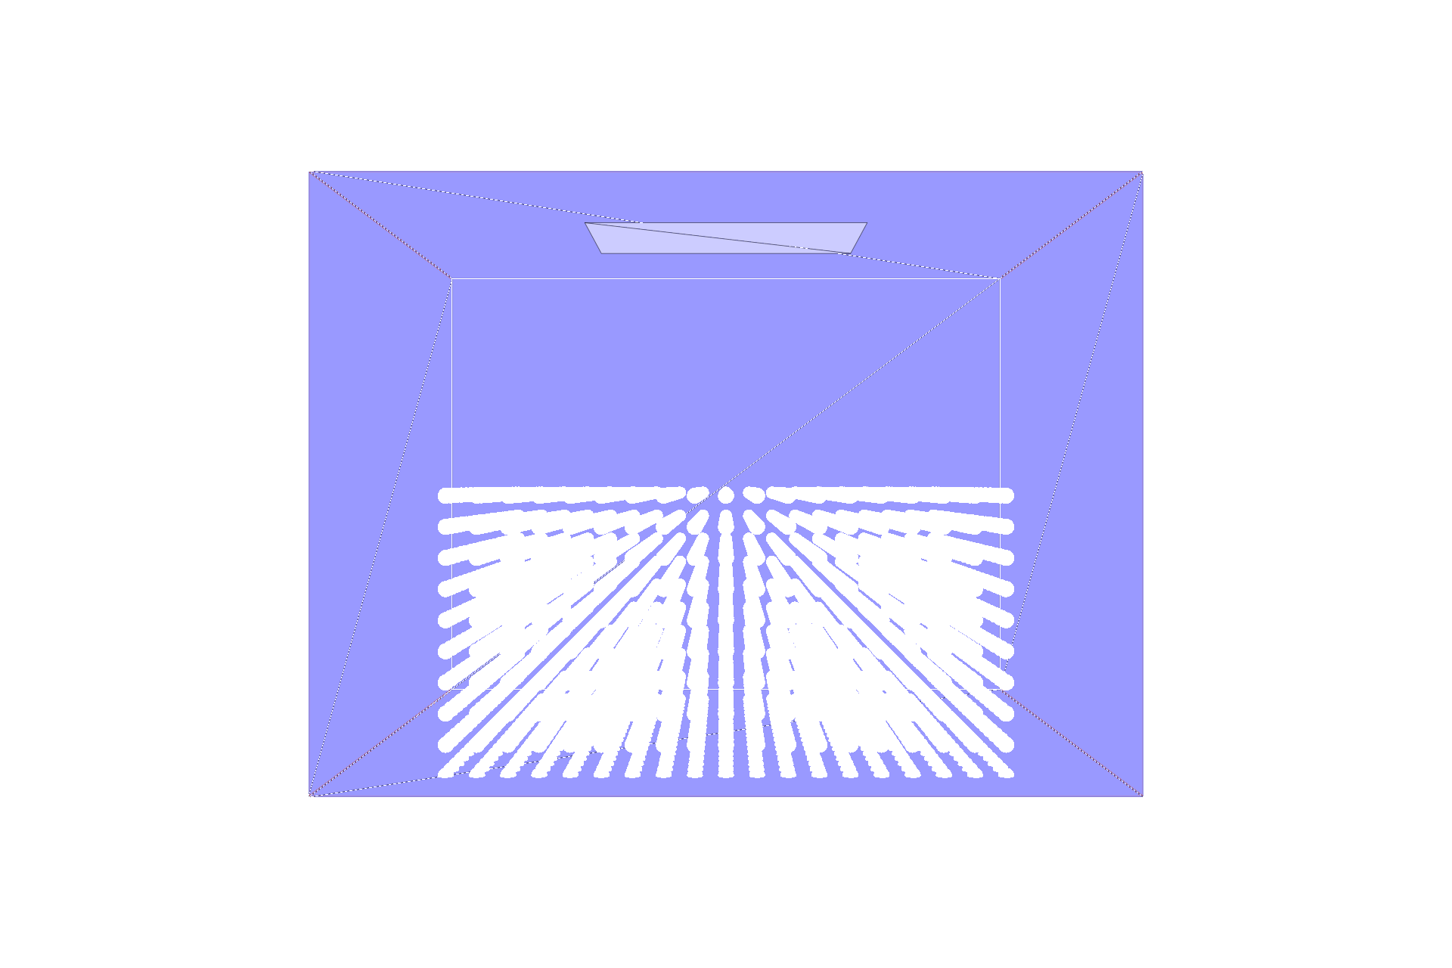
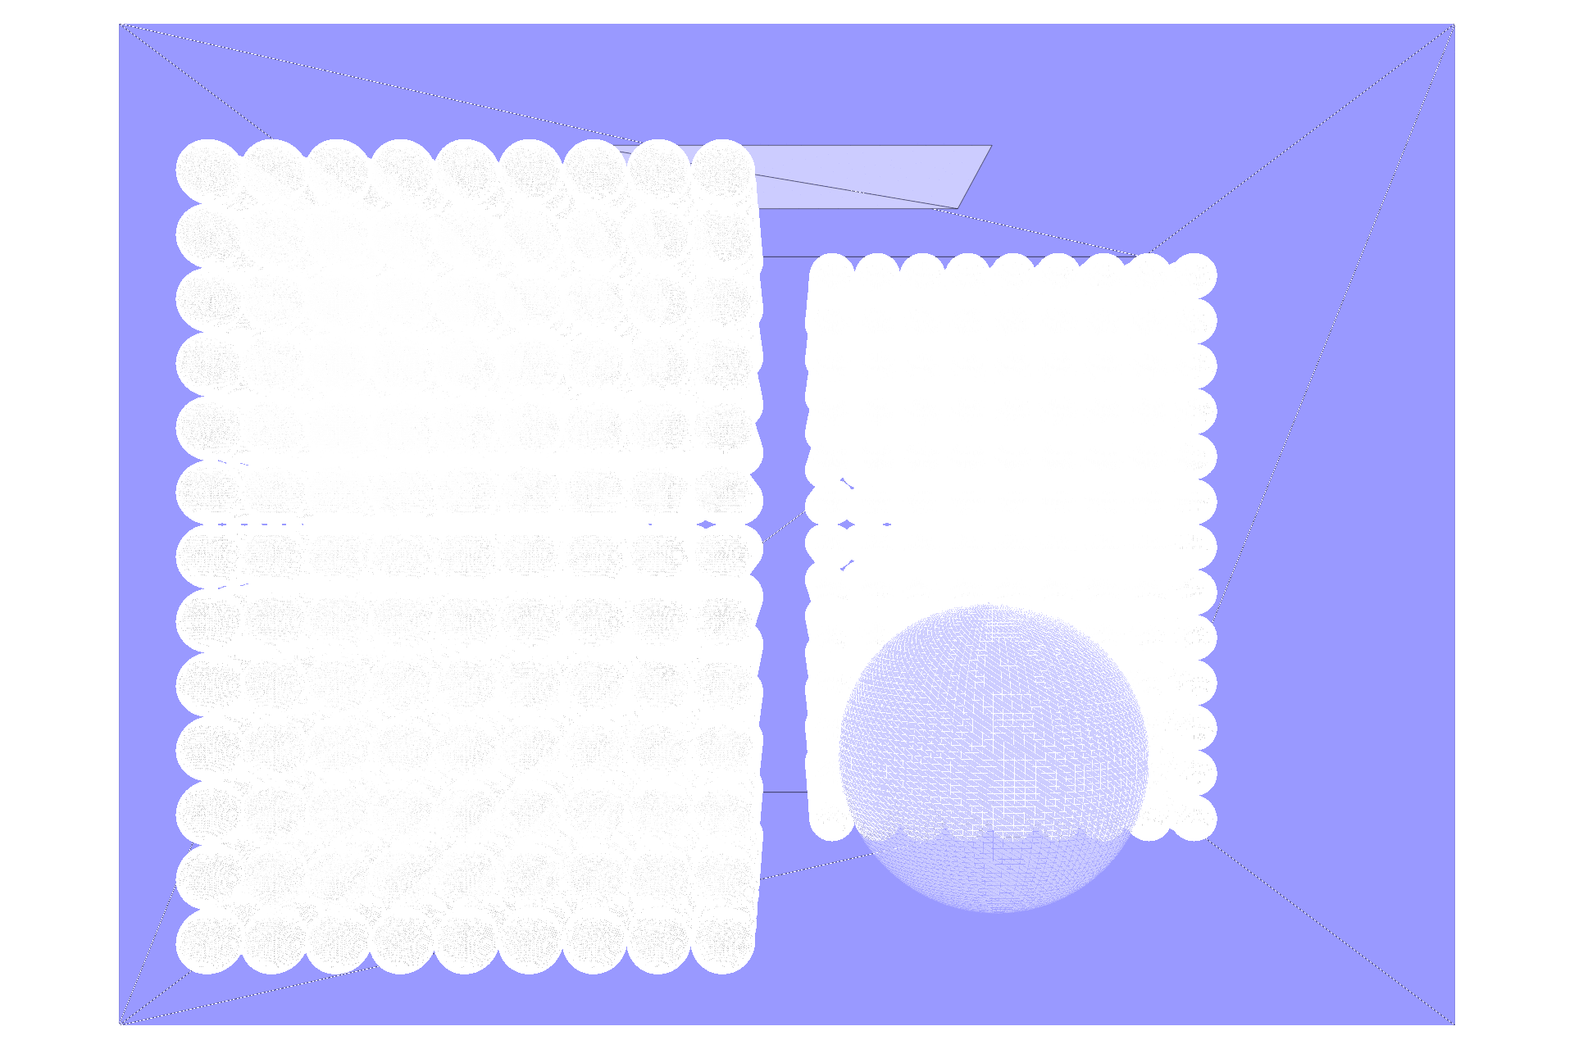
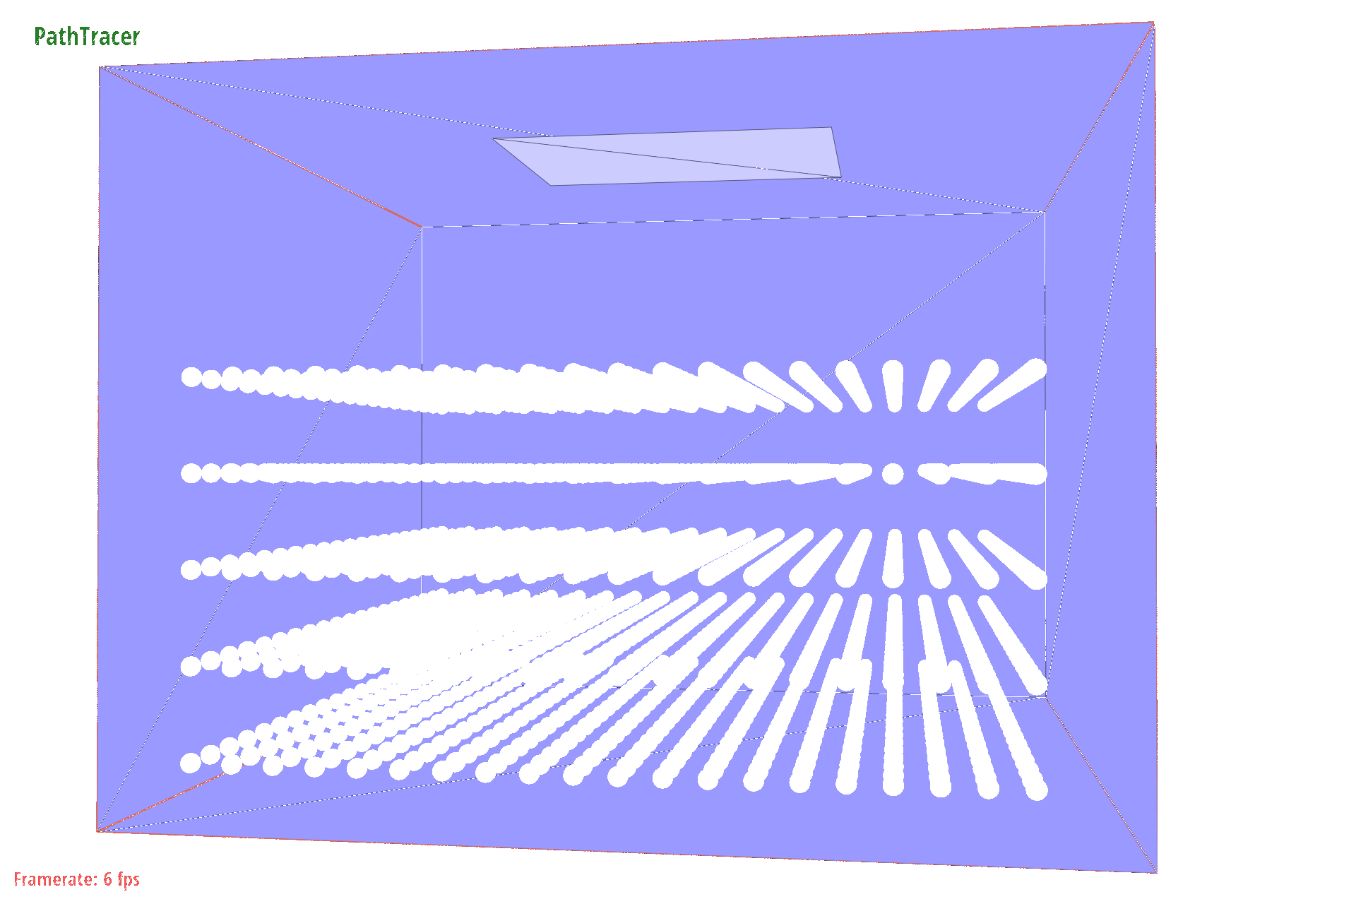
Fluid Particle Simulation results

Slide 3
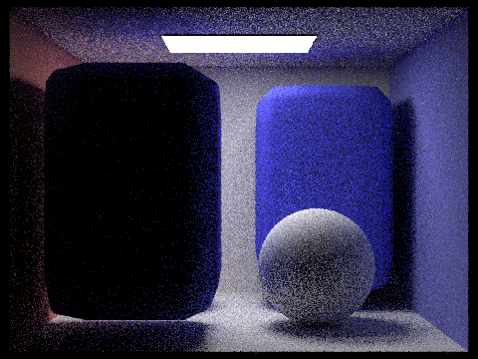
Final Rendering Result

Slide 4
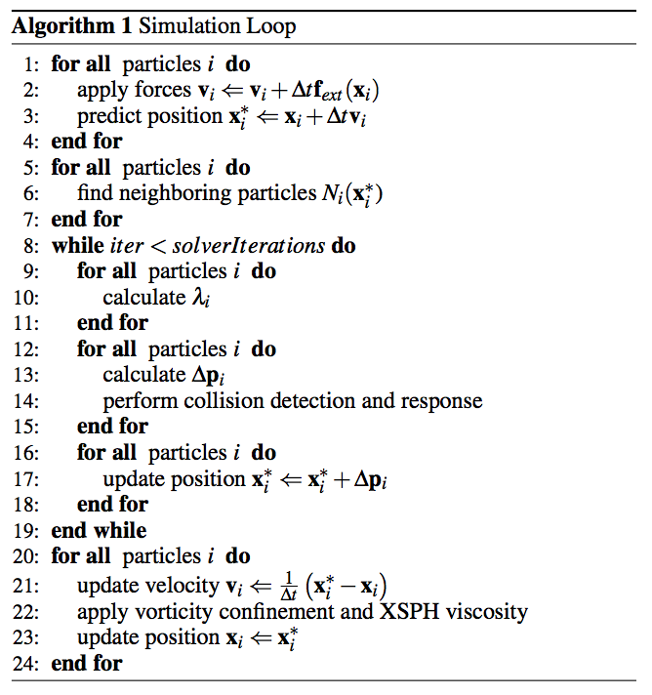
Problem 1: Fluid simulation
Challenges
Collision detection & response when particles hit objects.
Parameter tuning.
Speed up simulation (avoid redundant computation, grid-based neighbor finding, etc.).
Features
Command line option to load particles as xml file.
Key controlled simulation in visualization mode.
Visualization of densities using colored particles

Slide 5
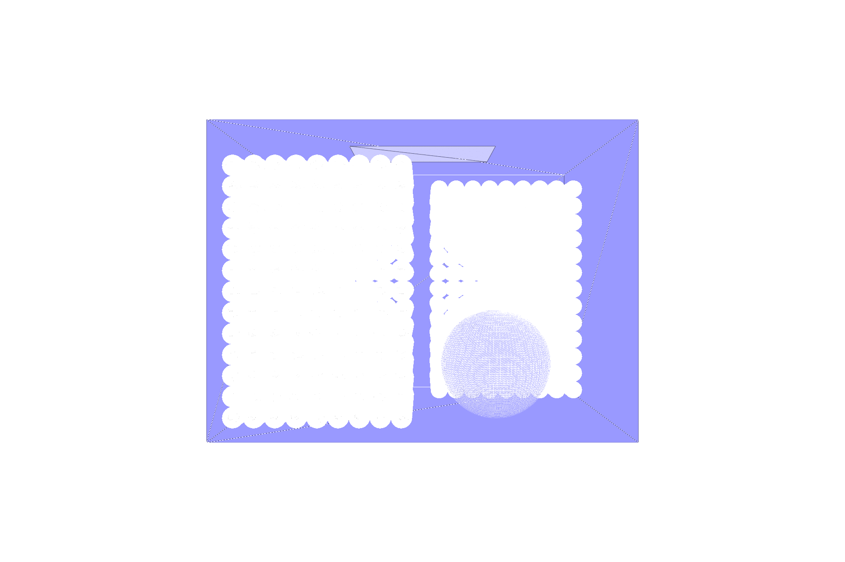
A Bug We Met
Notes:
Particles got stuck on the sphere object

Slide 6
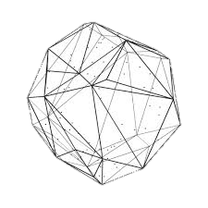
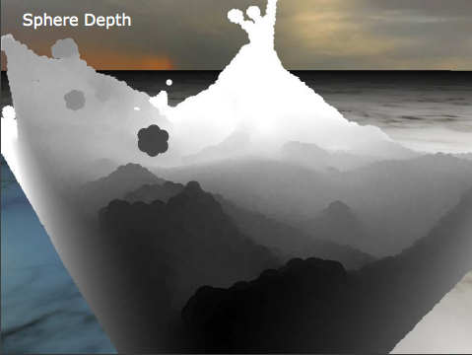
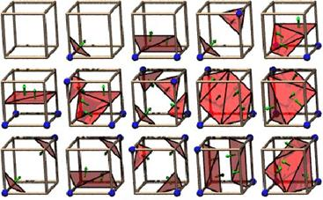
Problem 2: Surfacing
Option 1:
Visualize all particles as small spheres
Naïve, a temporary option to test fluid simulation
Option 2:
Visualize all particles as their convex hull
Could not work in practice (the convex hull may cut across a solid sphere)
Option 3:
Render as 2D depth map with water textures
Can’t raytrace the scene behind the fluid
Option 4:
Construct 3D surface using marching cubes
Final choice

Slide 7
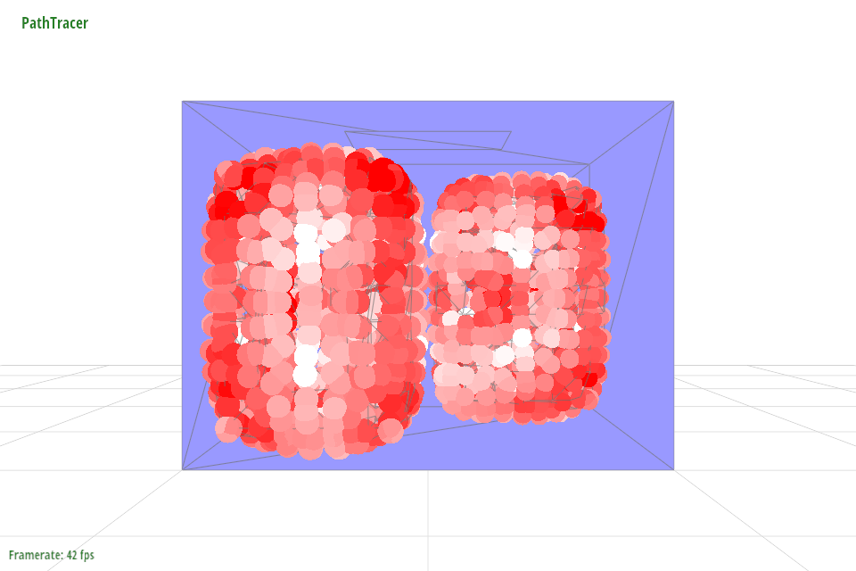
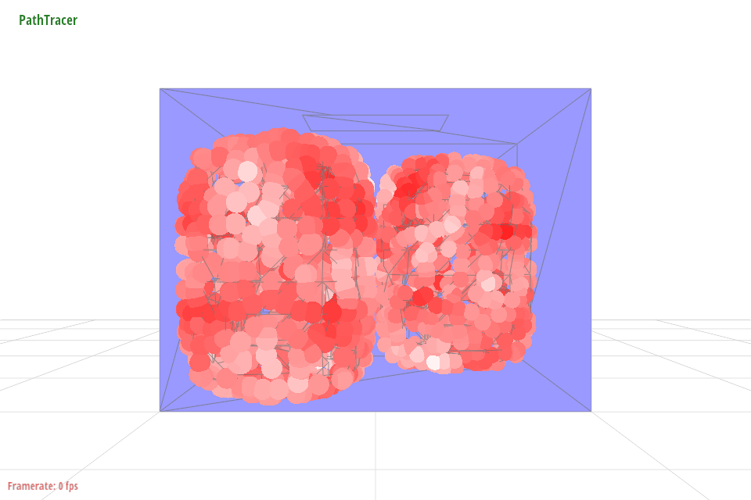
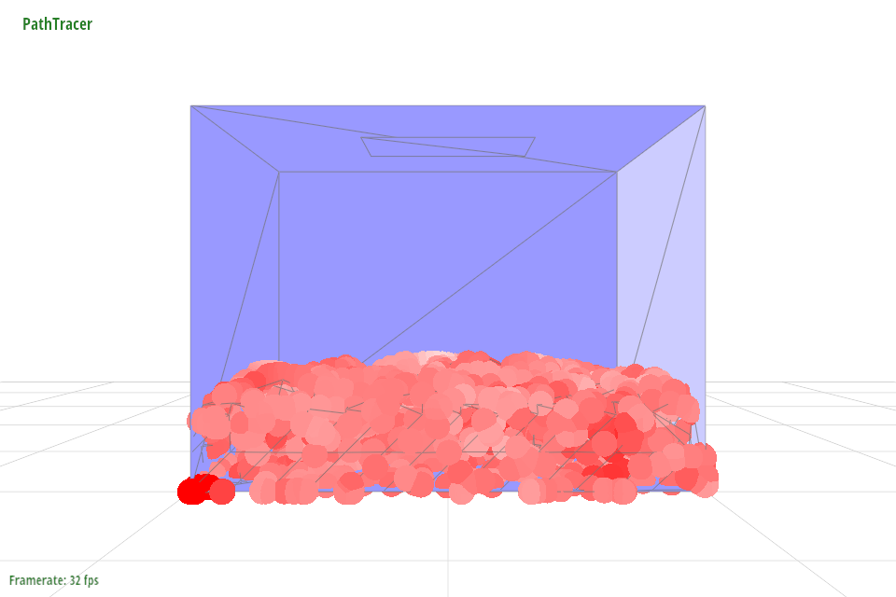
Surfacing results
Notes:
Show effects of using different BSDFs

Slide 8
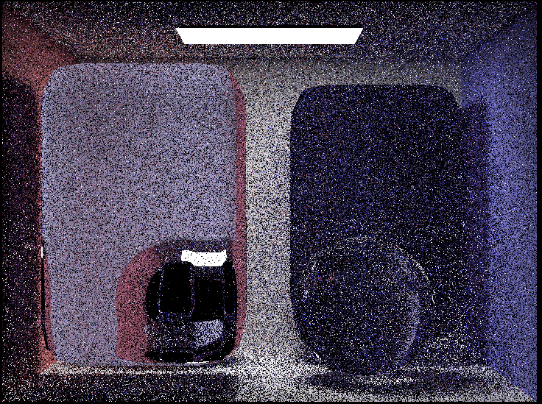
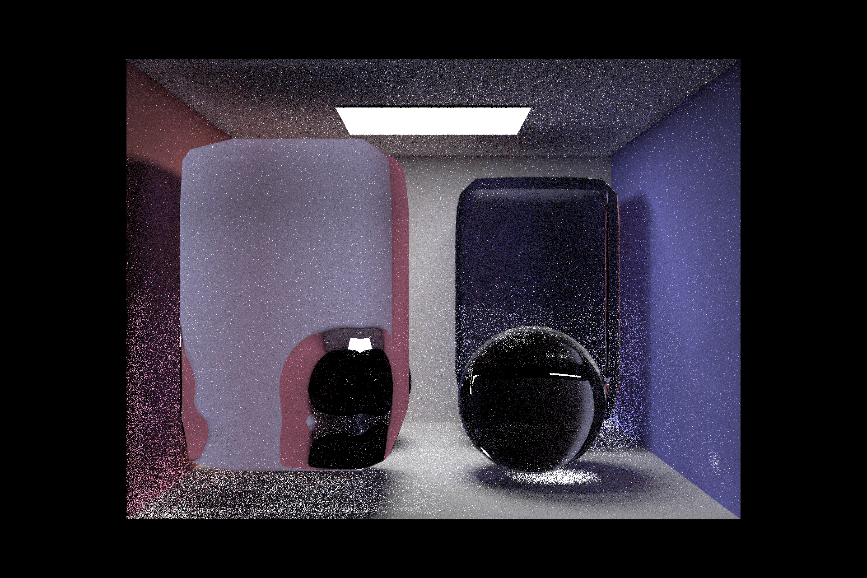
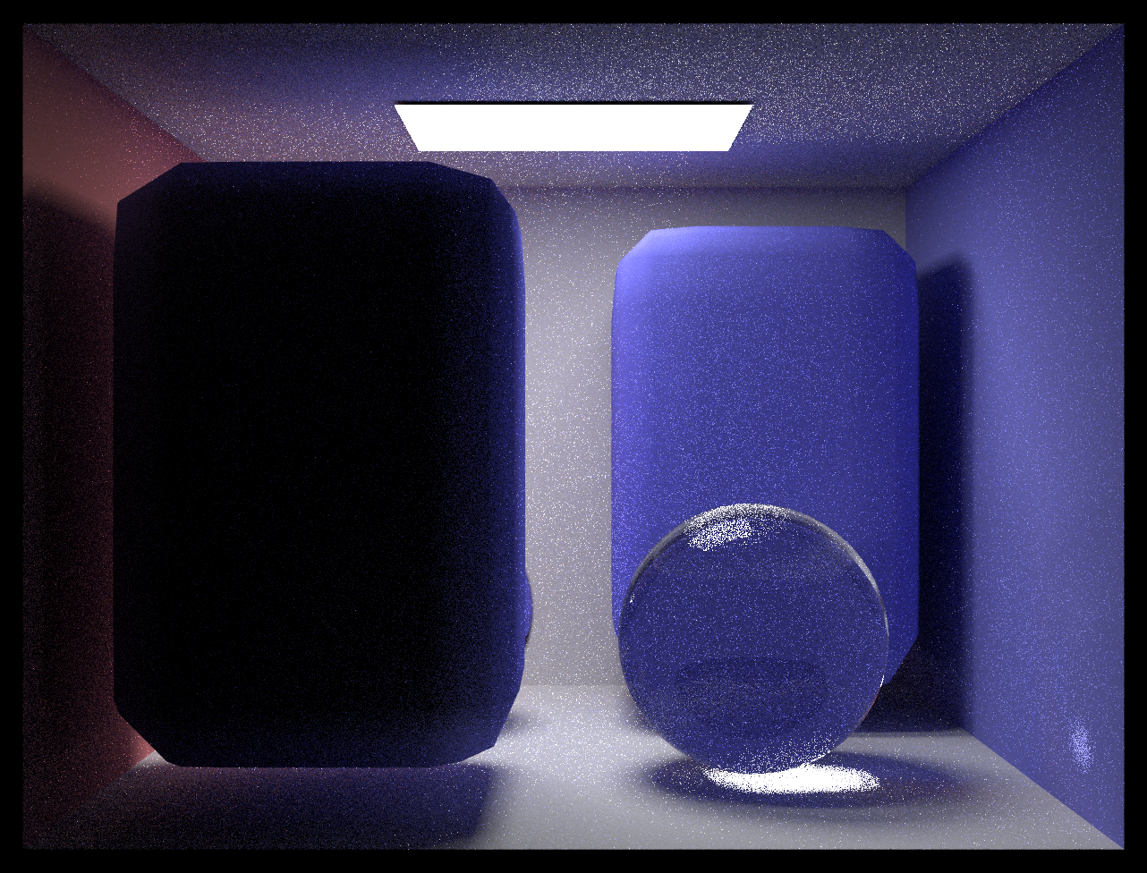
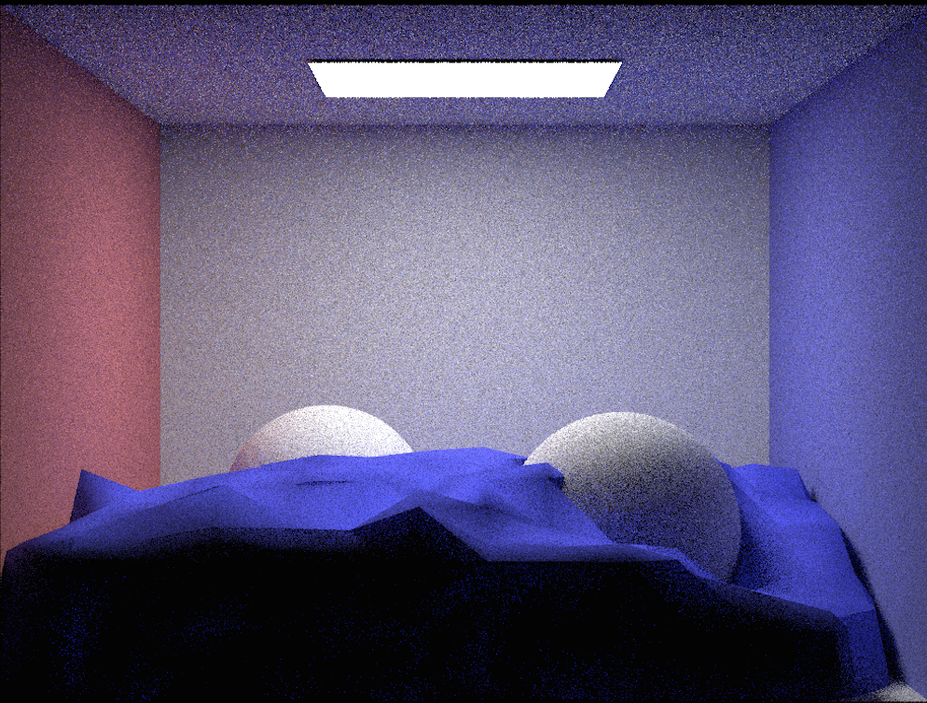
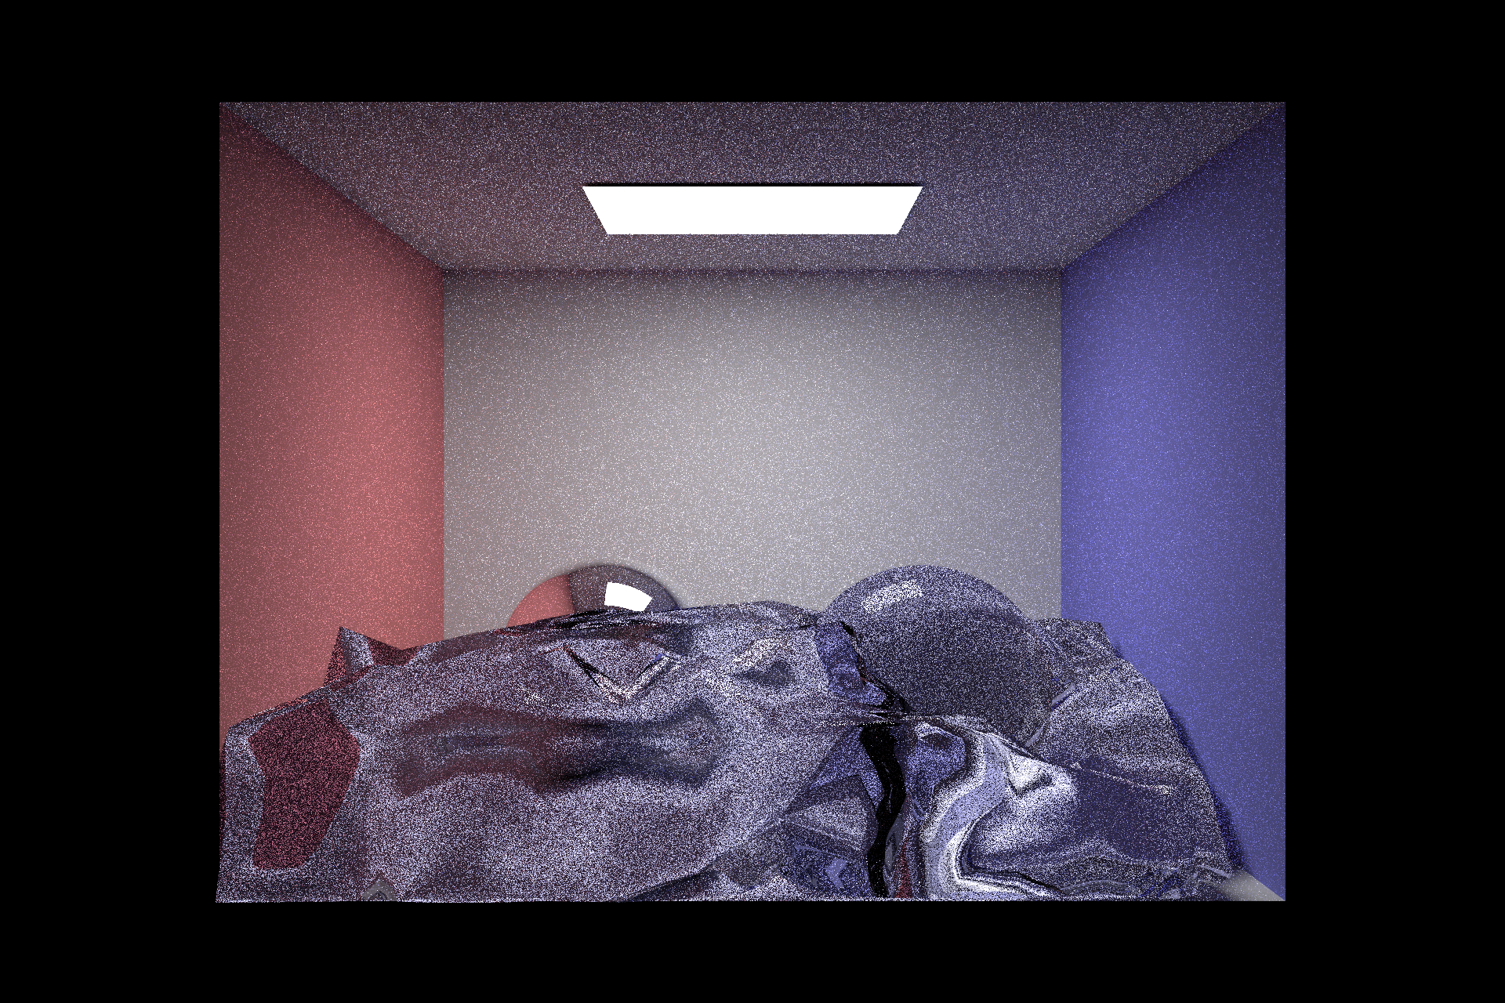
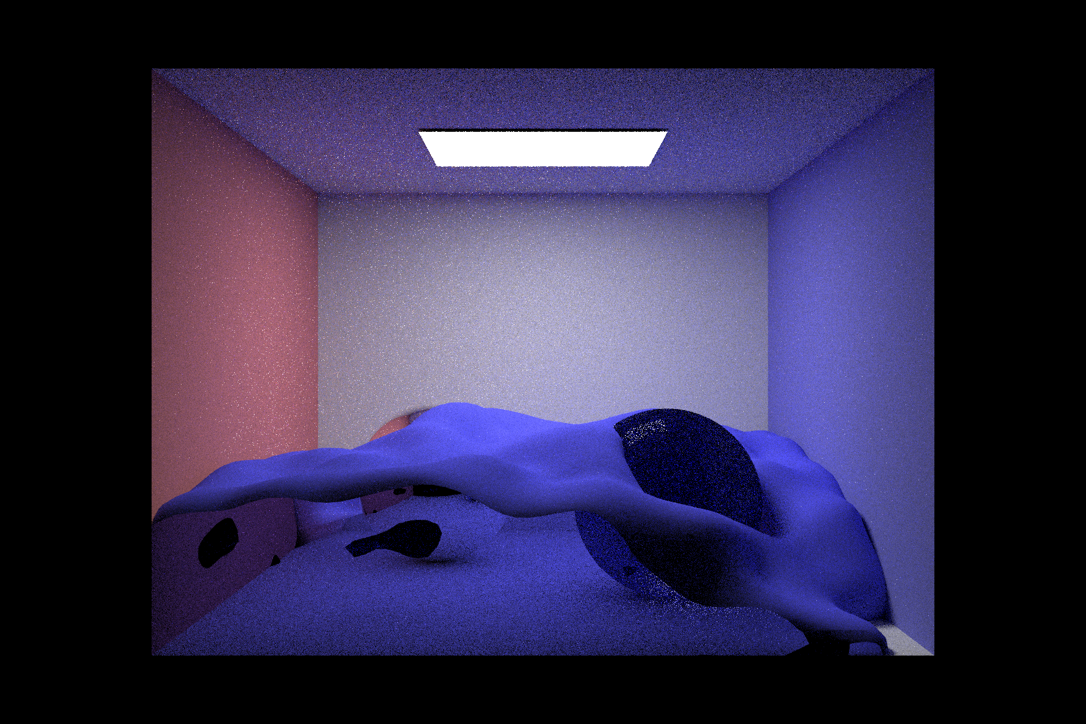
Rendering results
Notes:
Show effects of using different BSDFs

Slide 9
Notes:
Show effects of using different BSDFs

Slide 10
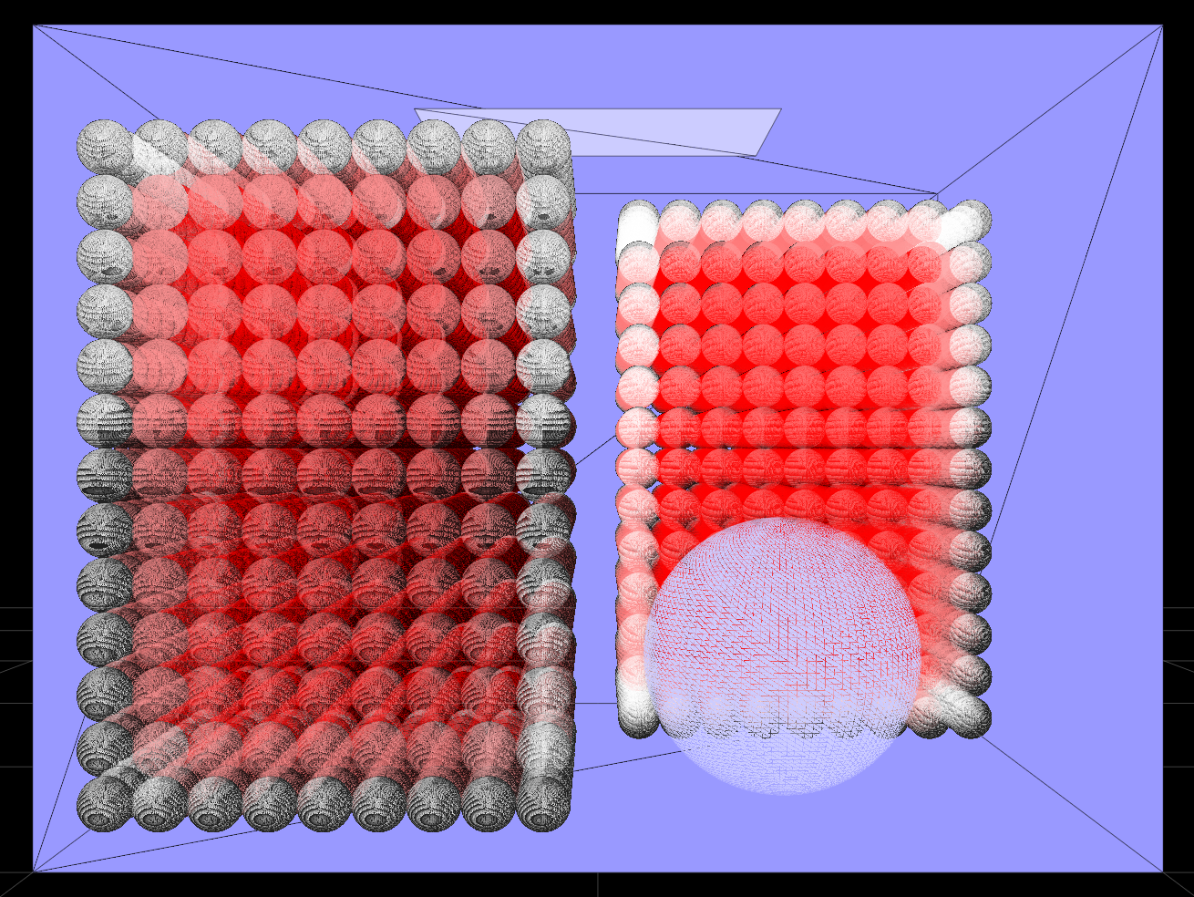
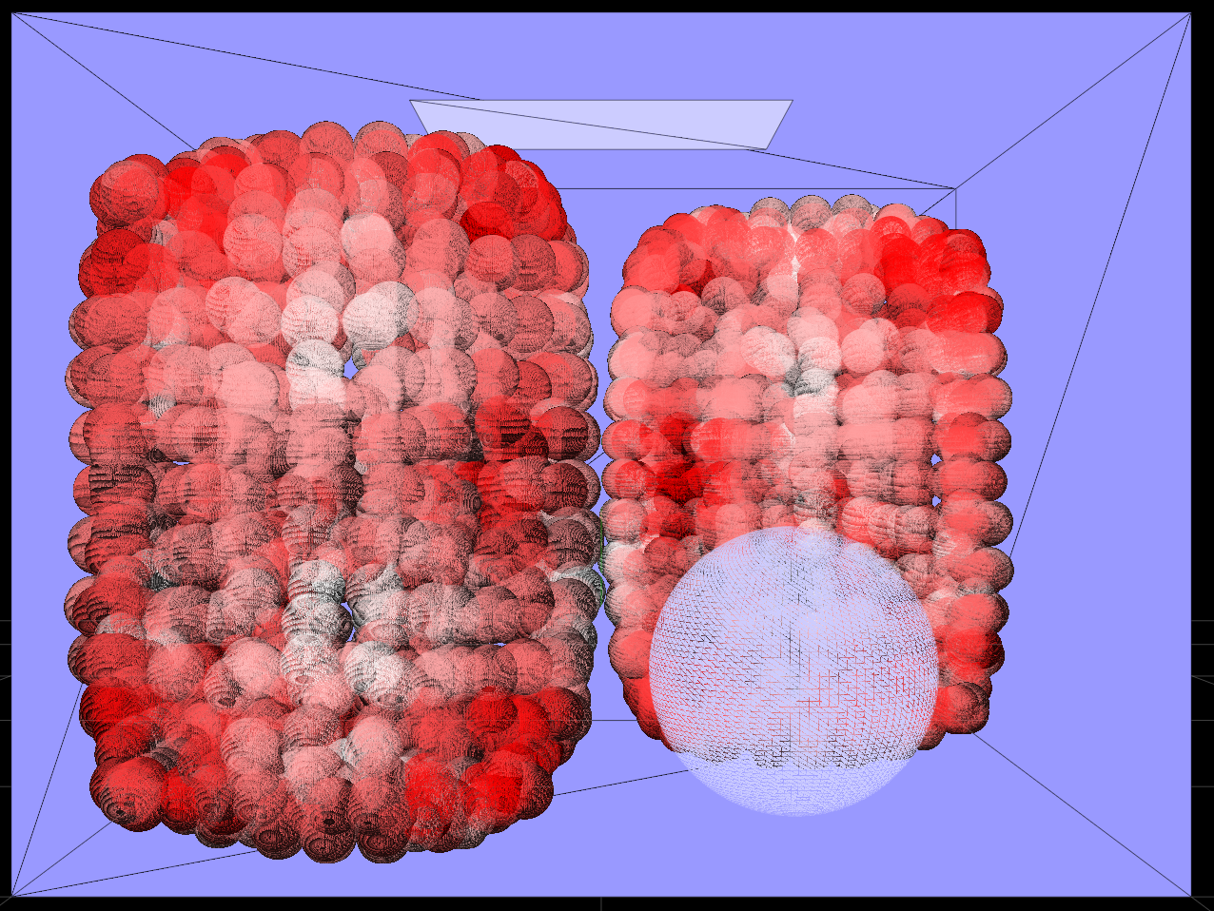
Lessons learned
1. Debugging using visualization is really helpful!!!
2. Various surfacing and rendering techniques: marching cubes, screen space rendering etc.

Slide 11
Thank you!

